Slide 1
32 BIT RISC PROCESSOR
Athul P – 16116012
Kaustubh Nayyar – 16116030
Khyati Kiyawat – 16111018
Shubhanshu Agarwal – 16118078
Sidharth Thomas – 16112087
Varun Rathore - 16116074
Under the guidance of Prof. Vaskar Raychoudhary

Slide 2
WHY RISC ?
Simple addressing modes
Simple instruction formats
Focuses on Software
Requires less Hardware
Fixed Size Instructions
Register-to-Register Operations
Single-Clock

Slide 3
INSTRUCTION SET ARCHITECTURE
“ISA is what lives for years while implementation may change”
Based on MIPS ISA with few modifications
Dual-Issue Superscalar design
With integrated assembler

Slide 4
INSTRUCTION FORMAT
R-Type :
Field Positions | 0pcode | rs | rt | rd | shamt | EXTRA BITS
Bit Positions | 31:26 | 25:21 | 20:16 | 15:11 | 10:6 | 5:0
I-Type :
Field Positions | Opcode | rs | rt | Address
Bit Positions | 31:26 | 25:21 | 20:16 | 15:0
J-Type :
Field Positions | Opcode | Address
Bit Positions | 31:26 | 25:0

Slide 5
INSTRUCTIONS
R-Type Instructions :
add
sub
and
or
xor
slt
J-Type Instructions :
jump

Slide 6
INSTRUCTIONS (con’d)
I-Type Instructions :
addi
andi
lw
sw
ori
xori
slti
bne
beq

Slide 7
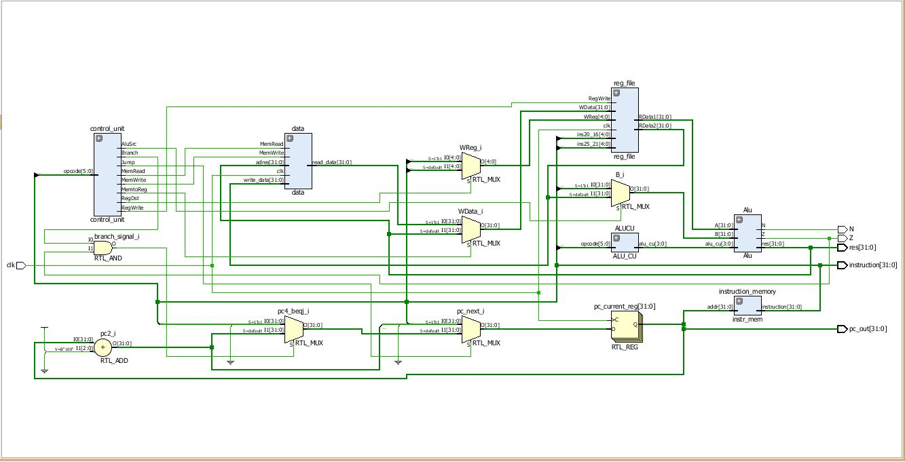
SCALAR DATAPATH
Fig : RTL Schematics of a single 32-bit processor

Slide 8
SUPER SCALAR DATAPATH
WHY SUPERSCALAR ?
Parallelism improves performance
Higher throughput
Faster than scalar rated at same clock frequency
LIMITATIONS
Limited amount of Instruction-Level Parallelism
More hardware, more cost
Limited by dependencies and resource conflicts

Slide 9
SUPER SCALAR DATAPATH
Fig : RTL Schematics of a 32-bit Dual-Issue Super Scalar Processor

Slide 10
SUPER SCALAR DATAPATH (contd.)
Fig : TestBench Waveform of a 32-bit Dual-Issue Super Scalar Processor

Slide 11
SUPER SCALAR DATAPATH (contd.)
Fig : TestBench Waveform of a 32-bit Dual-Issue Super Scalar Processor (without dependecies)

Slide 12
ASSEMBLER
NEED FOR AN ASSEMBLER :
Original design based on pre-loaded instructions in Instruction Memory
Having a High-Level Language input was not an option in Verilog
Assembler provides a platform for High-Level Language input
INSTRUCTIONS FORMATS :
R format – func $r1 $r2 $r3
lw/sw – lw/sw $r1 $r2 memory_value
I format – func $r1 $r2 constant_value
J format – j address_value

Slide 13
ASSEMBLER (contd.)
Fig : Testing the assembler in C++

Slide 14
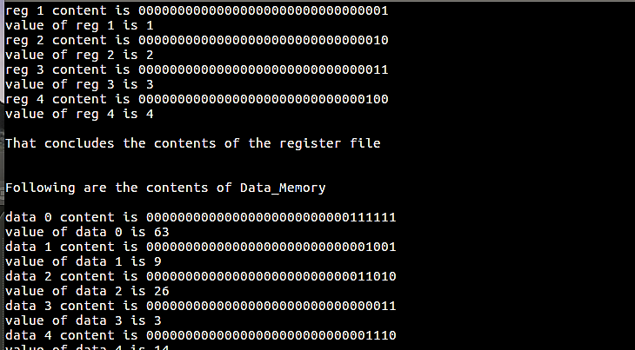
INSPECTION MODULE
Inspects the contents of any data location (registers or data memory) at a point of time
Stores this data in a text file in an ordered format
Fig : Running the inspection module in C++

Slide 15
SCOPE FOR FURTHER WORK
Introducing Pipelining into the current module
Including Out-of-Order issues and execution
Increasing the number of instructions
Implementing flexibility of instruction format based on GPR requirement
FPGA implementation of the processor

Slide 16
REFERENCES
Computer Organization and Architecture, 8th edition-William Stallings
Computer Organization and Design, 4th edition- D.A. Patterson, J.L. Hennessey
Digital Design and Computer Architecture- D.M. Harris, S.L. Harris
Computation Structures- MIT Course EECS 6.004
A Report on 16- bit RISC Processor by R.K.S. Parihar, S.Reddy (BITS Pilani)
www.ocf.Berkeley.edu
www.eg.buknell.edu

Slide 17


